Slide 1
Spring Cloud Config
By: Cryptic Team

Slide 2
Spring Cloud Config
Spring Cloud Config provides server and client- side support for externalized configuration in a distributed system.

Slide 3
Spring Cloud Config Server
With the Config Server we have a central place to manage external properties for applications across all environments.
As an application moves through the deployment pipeline from dev to test and into production we can manage the configuration between those environments and be certain that applications have everything they need to run when they migrate.
The Spring Config Server also supports version control of the configuration properties.

Slide 4
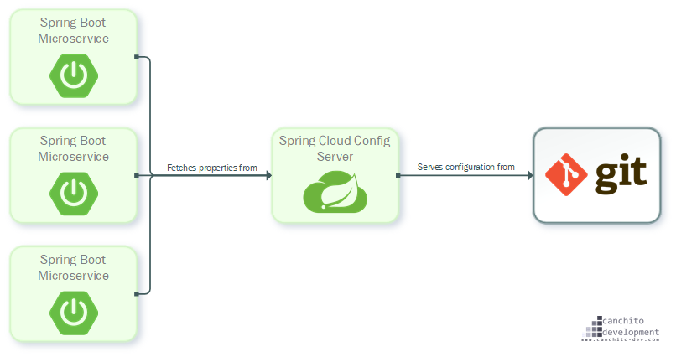
Config Server and Git
Spring config server stores properties in a version controlled repository like Git.
The architecture is shown below:

Slide 5
Features
Spring Cloud Config Server features:
HTTP, resource-based API for external configuration (name-value pairs, or equivalent YAML content)
Encrypt and decrypt property values (symmetric or asymmetric)
Embeddable easily in a Spring Boot application using @EnableConfigServer

Slide 6
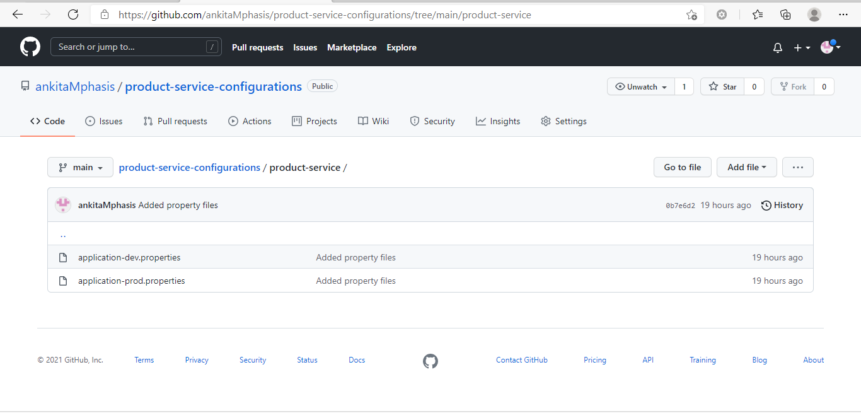
Creating Config Server
Step 1 - Setup a Github repository and upload application.properties file of your service.

Slide 7
Creating Config Server
Step 2: Create a Spring Starter Project and add following dependencies-
Config Server
Actuator

Slide 8
Creating Config Server
Step 3: In the main class, add annotation –
@EnableConfigServer
@SpringBootApplication
public class ConfigServerApplication {
public static void main(String[] args){
SpringApplication.run(ConfigServerApplication.class, args);
}
}

Slide 9
Creating Config Server
Step 4: In application.properties, add
server.port = 8888
spring.cloud.config.server.git.uri = http://github.com/ankitaMphasis/ product-service-configurations.git
spring.cloud.config.server.git.search-paths = {application}
spring.cloud.config.server.git.default-label = main
Step 5: Run the Spring Boot application to start the server.
Steps 6: Access the url to access the properties file-
https://localhost:8888/product-service/dev/main

Slide 10
Understanding the URL: Environment Repository
https://localhost:8888/product-service/dev/main
The HTTP service has resources in the following form:
/{application}/{profile}/{label}
{application} – injected as spring.config.name in the spring application.
{profile} – active profile (eg: dev,prod)
{label} – optional git label (default is main)

Slide 11
Config Client
A Microservice (SB Application) can act as config client to use the features of Config Server.
Step 1 - Dependencies to be added in pom.xml –
1. Spring cloud config starter
<dependency>
<groupId>org.springframework.cloud</groupId>
<artifactId>spring-cloud-starter-config</artifactId>
</dependency>
Actuator

Slide 12
Config Client
Steps 2 – Modify application.properties /bootstrap.properties
#location of config server
spring.cloud.config.uri = http://localhost:8888
#application name
spring.application.name = product-service
spring.config.import=configserver:
Step3 – Start the config server.
Step 4- Start the microservice.

Slide 13
Actuator
The /gateway actuator endpoint allows to monitor and interact with a Spring Cloud gateway application. To be remotely accessible, the endpoint has to be enabled and exposed via HTTP or JMX in the application.properties
application.properties
management.endpoints.web.exposure.include = *
/actuator/refresh – To clear the routes cache, make a POST request from any rest client.

